Slide 1
Disaster Preparedness and Response Education System for Schools and Colleges
CSE7302- University Project
FINAL VIVA
Batch Number: IST_6
Under the Supervision of,
Dr. Poornima S
Assistant Professor
School of Computer Science and Engineering
Presidency University
ROLL NUMBER | NAME
20221IST0036 | VARSHA B
20221IST0034 | MOUNIKA.M
20221IST0007 | MALLAKALUVA HEMANTH REDDY
Name of the Program: B.TECH
Name of the HoD: Dr.Pallavi R
Name of the Program Project Coordinator: Ms. Benitha Christinal J
Name of the School Project Coordinators: Dr. Sampath A K , Dr. Geetha A

Slide 2
Problem Statement Number: SIH25008
Organization: Government of Punjab
Category (Hardware / Software / Both) : Software
Problem Description:In India, schools and colleges are often unprepared for natural disasters such as earthquakes, floods, and fires. While emergency guidelines exist on paper, there is a lack of structured disaster management education integrated into the curriculum. Institutions lack digital tools to simulate disaster scenarios or conduct virtual drills to train students and staff on safety protocols.Furthermore, there’s a gap in localized awareness—many students are unaware of how to react during disasters specific to their region. Manual drills, where they occur, are infrequent and often poorly coordinated, failing to instill practical preparedness.

Slide 3
Project Goals and Objectives
The goal of this project is to create a comprehensive system that enhances disaster preparedness through interactive and data-driven methods
Provide structured learning modules
Enable simulation-based training
Offer real-time alerts and guidance
Track preparedness using analytics

Slide 4
Overview of Current Practices
Currently, most institutions rely on traditional approaches such as lectures, seminars, and occasional drills to address disaster preparedness.
These methods are not conducted regularly and often fail to engage students effectively.
Additionally, there is no proper mechanism to evaluate the effectiveness of such training programs, which limits their overall impact on preparedness.
Moreover, these approaches are mostly theoretical and do not provide hands-on experience or real-time decision-making practice.
Students and staff are rarely exposed to realistic emergency scenarios, which reduces their confidence during actual disasters.
The lack of digital tools and structured platforms further makes it difficult. As a result, preparedness remains superficial, highlighting the need for more interactive, practical, and technology-driven solutions.

Slide 5
Gaps in Existing Approaches
The existing methods of disaster preparedness suffer from several limitations, including the lack of real-time guidance, absence of simulation-based learning, and no system for continuous monitoring.
These gaps reduce the effectiveness of training programs and prevent institutions from accurately assessing the preparedness levels of students and staff, ultimately affecting their ability to respond efficiently during emergencies.
In addition, traditional approaches are often irregular and not standardized, which leads to inconsistent learning outcomes across different institutions.
The lack of interactive and engaging training methods also results in low student participation and poor knowledge retention.
Furthermore, there is minimal use of technology to track progress, analyze performance, or provide personalized feedback. These shortcomings highlight the need for a more structured, technology-driven, and continuously monitored disaster preparedness system.

Slide 6
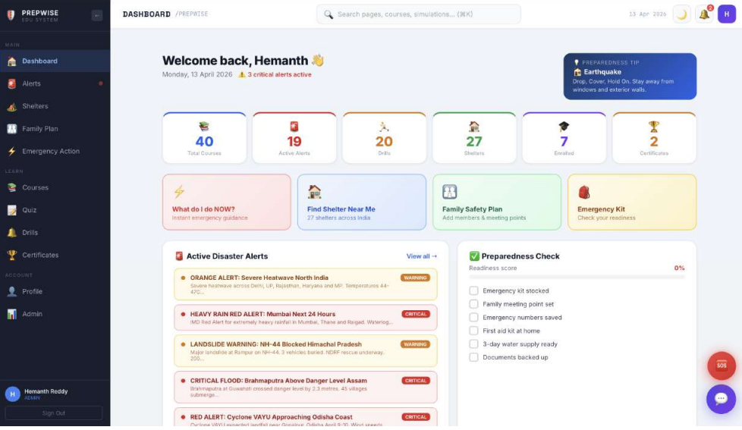
Proposed Solution – PREPWISE Platform
To address these challenges, the PREPWISE platform is proposed as a comprehensive digital solution for disaster preparedness.
The system integrates interactive learning modules, virtual disaster simulations, real-time alert systems, and an AI-based chatbot to provide continuous guidance.
It also includes an analytics dashboard that helps institutions track participation and preparedness levels, ensuring a more effective and structured approach to disaster education.

Slide 7
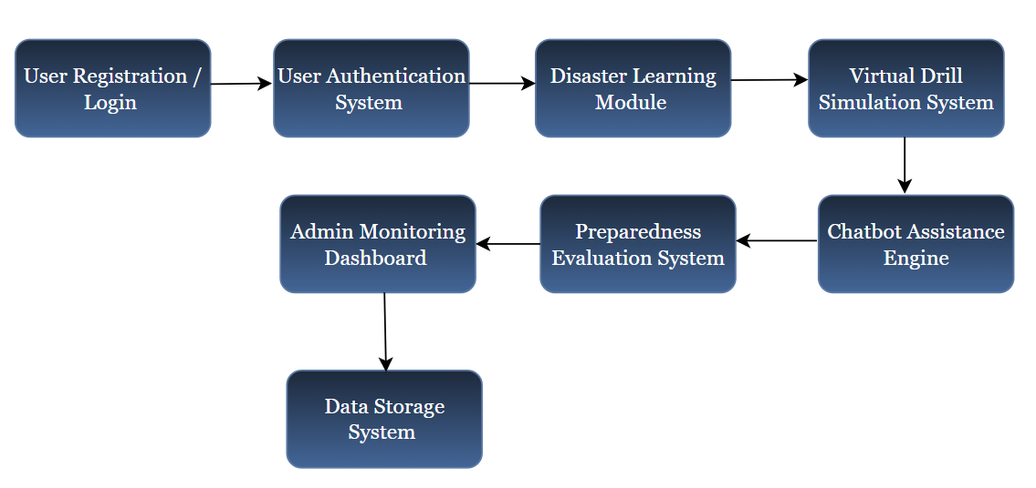
System Design Overview
The system architecture shows the overall flow of the PREPWISE platform. It starts with user registration and login, followed by secure authentication. After logging in, users access the disaster learning module to gain knowledge about safety and emergency procedures.
They then participate in virtual drill simulations to practice real-life scenarios. The chatbot provides instant guidance and support whenever needed. User performance is evaluated through the preparedness evaluation system, and the results are monitored by administrators using the dashboard. Finally, all user data and performance records are securely stored in the data storage system for analysis and future use.

Slide 8
Core Functional Modules
The platform consists of several integrated modules that work together to provide a complete disaster preparedness solution.
The learning module delivers structured educational content, while the simulation module allows users to experience virtual disaster scenarios.
The alert system provides real-time notifications, and the chatbot offers instant guidance.
Additionally, the dashboard module enables administrators to monitor performance and preparedness levels.

Slide 9
Technology Stack
Frontend Technologies
React 18 with Vite is used to build a fast and responsive user interface with efficient rendering and development speed.
React Router v6 enables smooth navigation between different pages such as dashboard, alerts, and learning modules.
Axios and Fetch API are used to handle communication between frontend and backend services through API requests.
JsPDF is integrated to generate digital certificates for users after completing training modules and drills.
Backend Technologies
Node.js with Express.js is used to develop the server-side logic and handle API requests efficiently.
MySQL with Sequelize ORM manages structured data such as user records, performance scores, and system logs.
MongoDB with Mongoose is used for handling flexible data such as chatbot interactions and dynamic content.
JWT (JSON Web Token) is implemented for secure user authentication and session management.
bcryptjs is used to securely hash user passwords and protect sensitive data.

Slide 10
Final Outcomes and Future Scope
The proposed system successfully bridges the gap between theoretical knowledge and practical disaster preparedness.
It enhances awareness, improves confidence, and enables better decision-making during emergencies. By combining interactive learning with real-time guidance and performance analytics, the platform promotes continuous preparedness rather than occasional training.
It also supports institutions in monitoring readiness levels and identifying areas that require improvement, thereby strengthening overall campus safety and resilience.
Future enhancements may include the integration of Artificial Intelligence and Machine Learning for predictive risk analysis and personalized training recommendations.
Technologies such as Virtual Reality and Augmented Reality can be incorporated to create more immersive and realistic simulation experiences.
Further improvements can also include multilingual support and advanced analytics to make the system more inclusive, scalable, and effective across diverse educational environments.

Slide 11
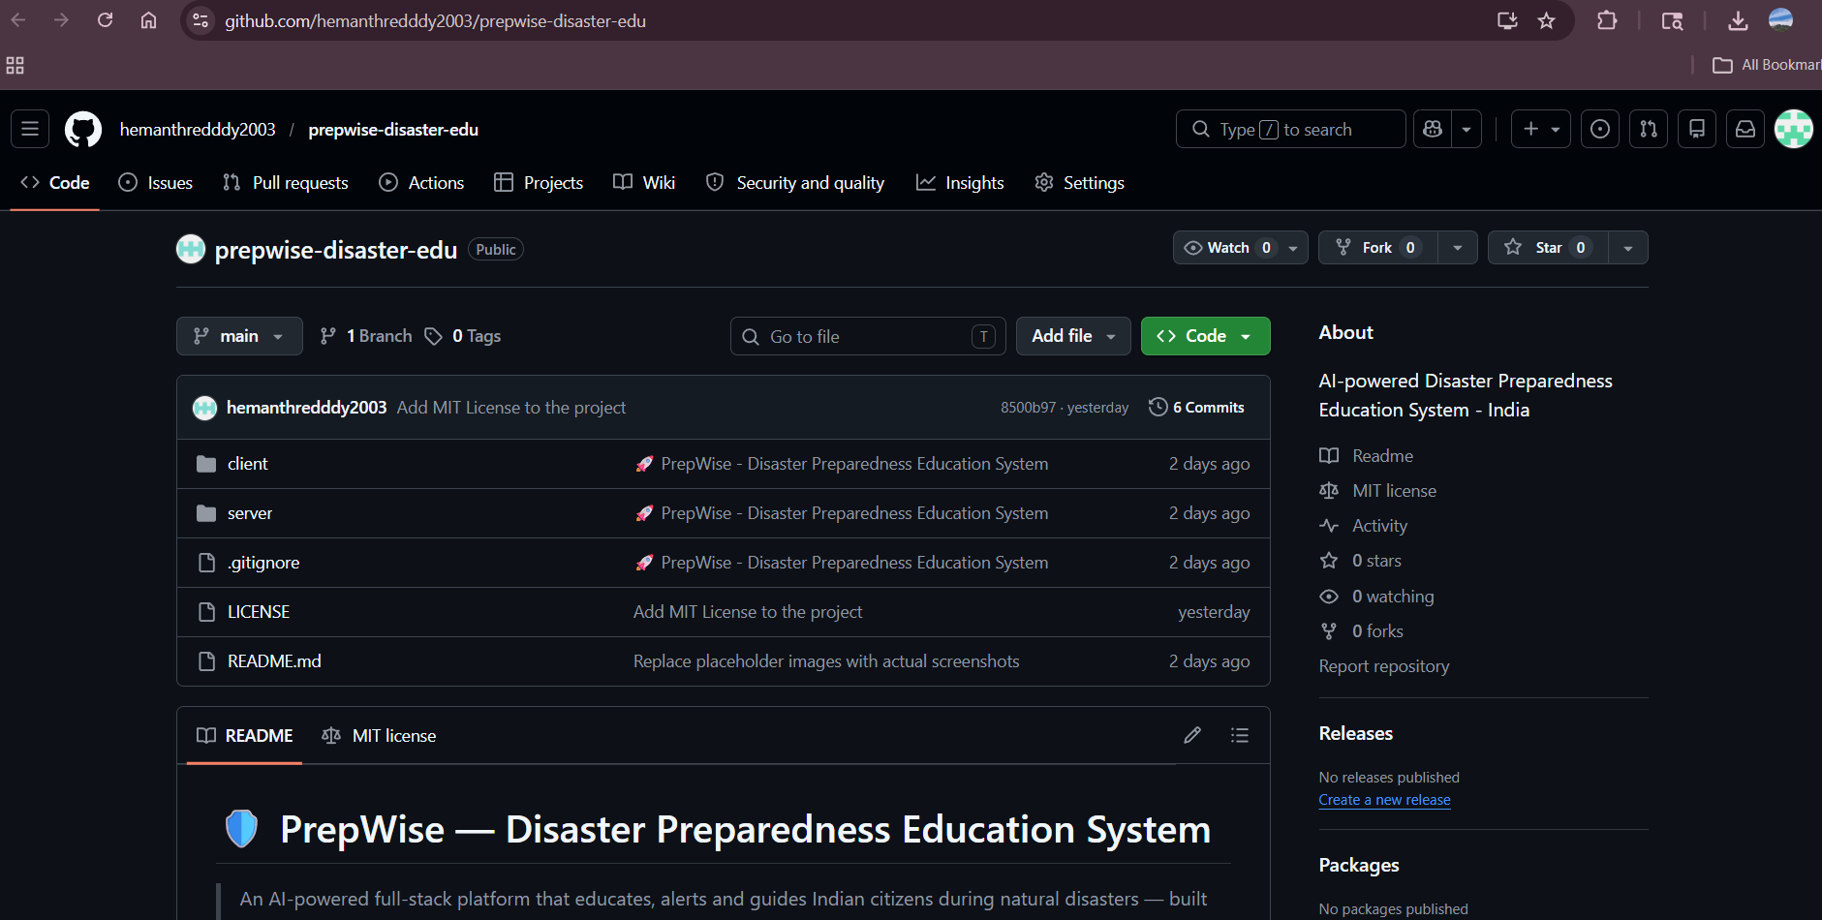
Github Link
Repository Link:
https://github.com/hemanthredddy2003/prepwise-disaster-edu

Slide 12


